Slide 1

GROCERY SHOP APP
Group 5:
658 Avdhoot Tavhare
659 Rohit Pingale

Slide 2
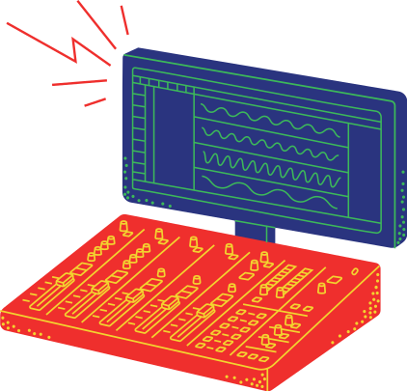
Anaconda Navigator
Platform used in Project.
Visual Studio Code
GUI - TkInter

Slide 3

Basically this app is about billing, and kind of menu card of the grocery shop,as in this environment of COVID scenes people are more awared towards safety.
So this application will help to choose which product the customer wants and along with that price and quantity tab we are going to provide, we will make it more user friendly and also making it contactless.
And in the end, we are going to add Billing tab which will display the final amount to be paid.
Brief Idea about the Project:

Slide 4
While creating the Grocery Shop Bill Calculator, we have to import some libraries such as TkInter (which is also used in making GUI-Graphical User Interface). We will be importing all the necessary things required .
We will take the input from the user of the quantities of the groceries, and assign them different values. Whenever the user wants to buy a particular thing from the section, he/she needs to enter the quantity and automatically, the application will calculate the amount based on the quantities entered
About the Application:

Slide 5
We will be adding different widget into the GUI window such as Labels: to display the name of the product , Text Fields: to provide the quantity of the particular thing, Button: to display the overall bill, clear the window, to exit the application , etc.
The "Overall Bill" Button will be provided in GUI which will display the Final Bill which the customer will receive. The Final Bill Receipt will be printed in the Text Area / Label Frame, which is displayed in the GUI. The "Exit" Button in the GUI will close the running application.
About the Application:

Slide 6
Functions To be used in GUI
Main Functions
pip install tk-
Installs TKinter library into the existing Python.
import tkinter as tk-
It imports TkInter library as abbrevation of tk.
From tkinter import * -
It will include all the library sources which are necessary to run the GUI Application

Slide 7
For Creating GUI Window
Canvas- used to add structured graphics/colours.
Frame Function: It works like a container, which is responsible for arranging the position of other widgets, which makes the GUI more user friendly
.title( )- this defines the title for the GUI window
.geometry( )- it defines the layout of the GUI Window
tk.Frame( )- This Function allows us to define a particular frame in the Canvas. In this Case, the frame is in white colour
.mainloop()- It tells Python to run the Tkinter event loop

Slide 8
All the Widgets used in the GUI
We have used different kinds of Widgets which are available in the TkInter Library, such as:
Label() Widget: This widget will add texts into the GUI
LabelFrame(): A labelframe is a simple container widget. Its primary purpose is to act as a spacer or container for complex window layouts.
Button(): This widget will add buttons into the GUI with command as a attribute, which is compulsory
ScrollBar(): This widget provides a slide controller that is used to implement vertical scrolled widgets, such as Listbox, Text

Slide 9
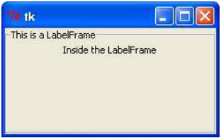
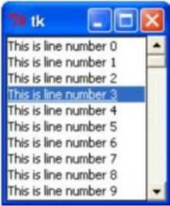
About the Final Billing Area
We will be adding a Simple Text Area/Label Frame into the Billing area of the GUI.
Later on, if the bill is long enough, and consider it doesn't fit in the given Text Area/Label Frame, we have also added the ScrollBar Widget so that it will add scrolling capability to the Text Area / Label Frame.
The figure alongside represents the Text Area / Label Frame Widget (upper one) alongwith the ScrollBar Widget (lower one)

Slide 10
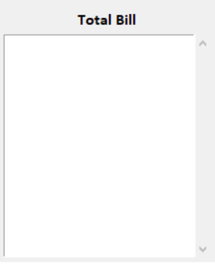
About the Final Billing Area
The Final Billing Area, with the combination of Text Area/Label Frame Widget and ScrollBar Widget will look something just like this:

Slide 11
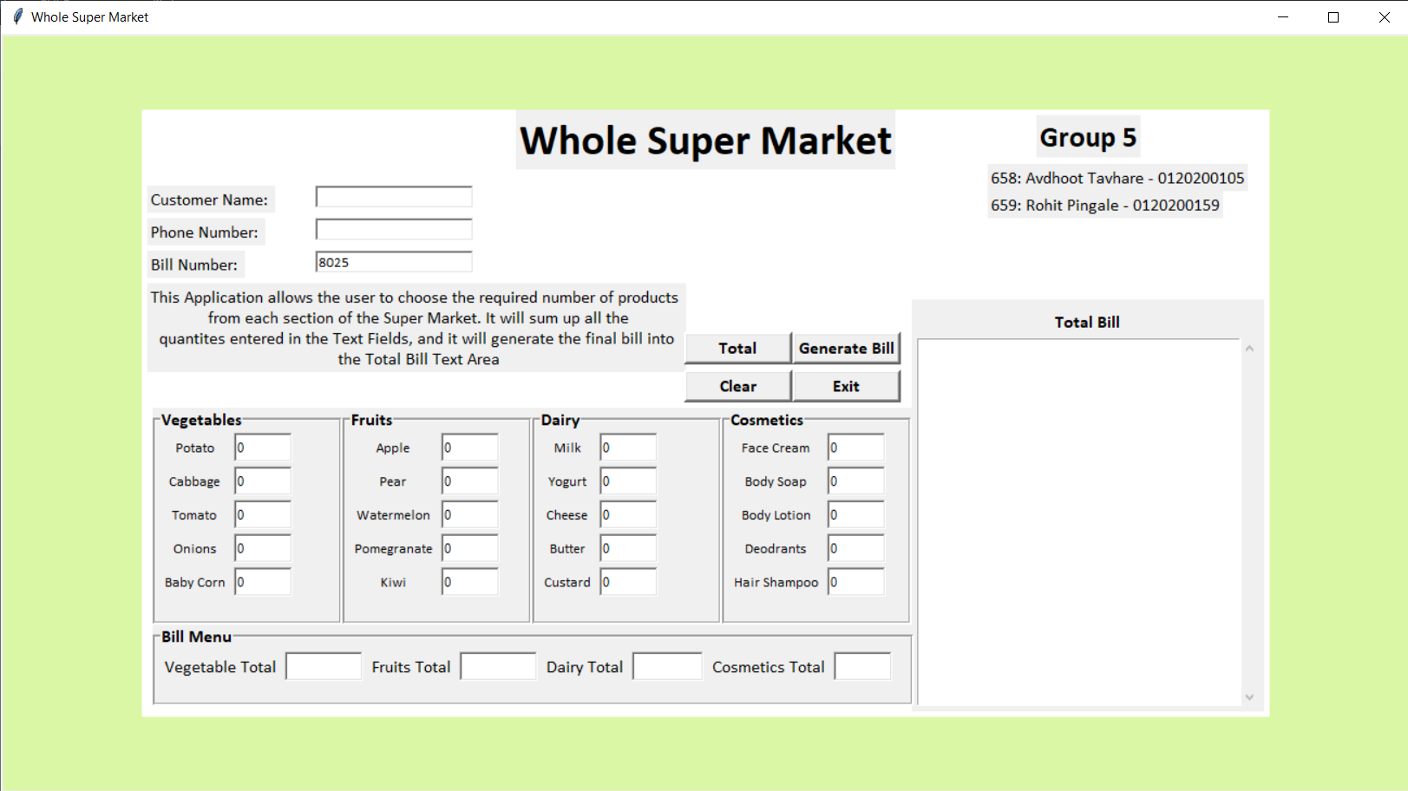
Our Project's GUI Window

Slide 12
Minimum System Requirements
To Run this application successfully, we need the following system requirements:
Hardware - The User must have the latest version of Windows/Mac/Linux Operating Systems.
Software - In those operating system, Python Version 3.8.9 or above must be installed.
Software - TkInter Library for GUI, Anaconda Navigator / Visual Studio Code

Slide 13


